Slide 1
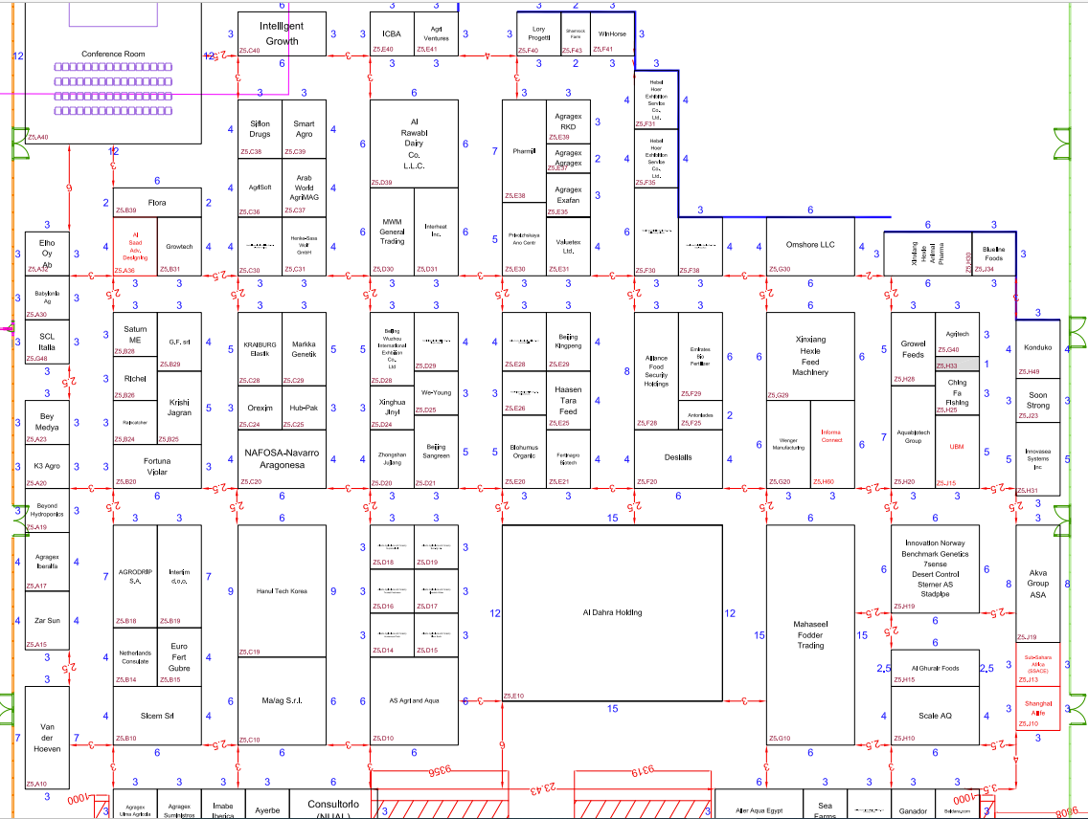
7m
22.5m
6
WIFI sensor
1
5
14.5m
4
31m
14.5m
50m
2
26.5m
3
28.5m
70m
15m

Slide 2
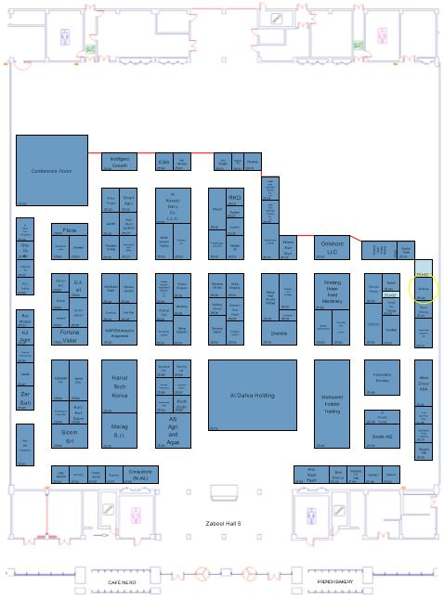

Slide 3

